Slide 1

STUDENT INDUSTRIAL WORK EXPERIENCE SCHEME (SIWES) AT MICOSIMON NETWORK TECHNOLOGY AHMEDU BELLO WAY, KADUNA, KADUNA STATE PRESENTED BY ABRAHAM JESSE GIDEON 16/SC/CO/499 TO DEPARTMENT OF COMPUTER SCIENCE FACULTY OF SCIENCE UNIVERSITY OF UYO, UYO

Slide 2
OUTLINE
Introduction
Place of Industrial Attachment
My work Experiences
About web Development
Sample mini Project

Slide 3
INTRODUCTION
The implementation of SIWES this year was very beneficial to me. This presentation covers the basic details of my work and learning experiences during the over six months Industrial Training I undertook at MICOSIMON Network Tech.

Slide 4
PLACE OF INDUSTRIAL ATTACHMENT
I took my industrial attachment at Micosimon network technology, at Ahmedu bello way oppsite new Nigeria news paper kaduna state. It’s a information and communication technology company with broad expertise in ICT consultancy. Micosimon network Technologies is a Nigerian based telecommunications and technology conglomerate offering a wide range of automated and integrated solution in broad spectrum of computers and telecommunication technology to its clients.

Slide 5
MY WORK EXPERIENCE
During my stay at MICOSIMON, I was groomed through the following areas of ICT:
Website Design and Development.
MysqlAdmin(Php).

Slide 6
ABOUT WEB DEVELOPMENT
Web development is the coding or programming that enables website functionality, per the owner's requirements. It mainly deals with the non-design aspect of building websites, which includes coding and writing markup.
The technologies used for web development include Ajax, PHP (Hypertext pre-processor), JQuery, HTML5 JavaScript, CSS, ASP. Net, Bootstrap , MySQL etc.

Slide 7
WEB DESIGN AND DEVELOPMENT
Web Design and Development is the design and programming that enables website functionality, based on the owner's requirements.
It is a combination of user interface designs, structural designs, server coding, of a website for access through the internet.
The World Wide Web (abbreviated WWW or the Web) is an information space where documents and other web resources are identified by Uniform Resource Locators (URLs), interlinked by hypertext links, and can be accessed via the Internet using an internet-enabled device e.g. Computers, Tablets, and Mobile Devices.

Slide 8
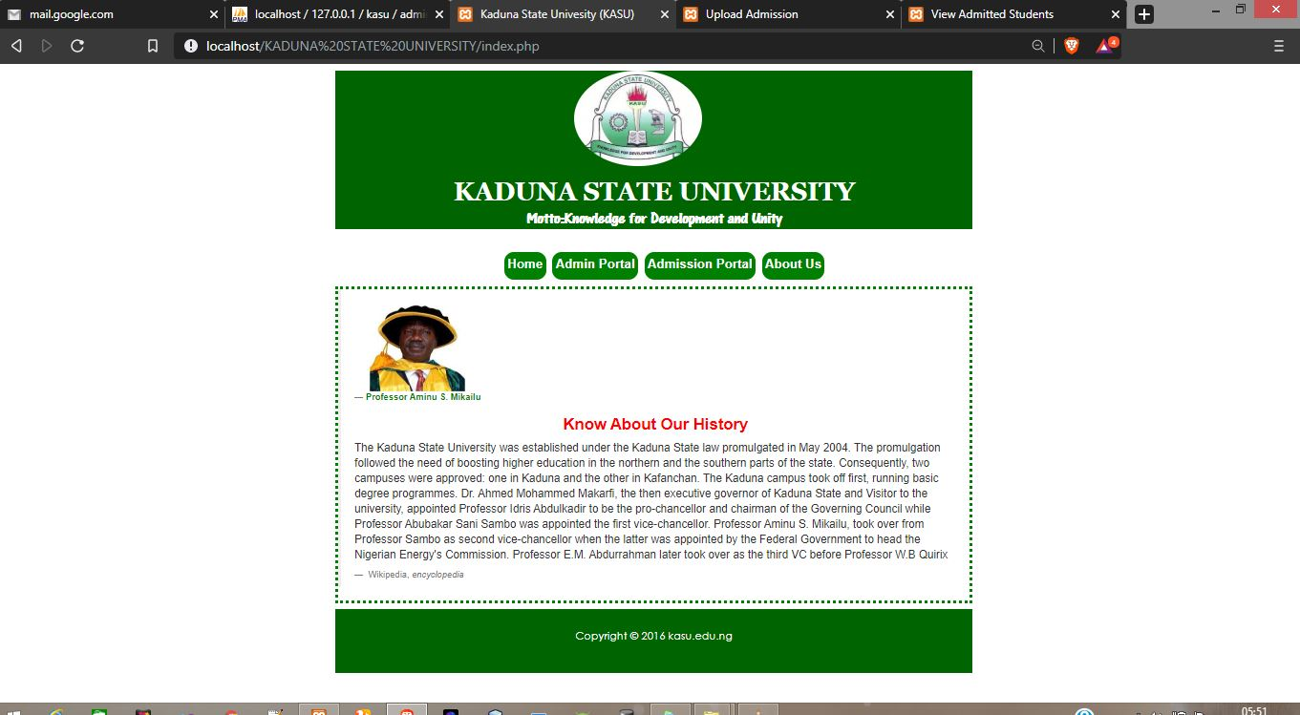
ADMISSION PROCESSING HOME PAGE

Slide 9
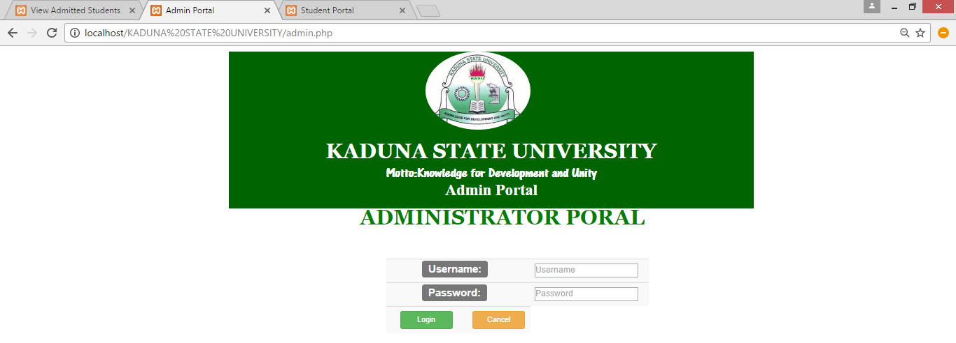
ADMIN LOGIN PAGE

Slide 10
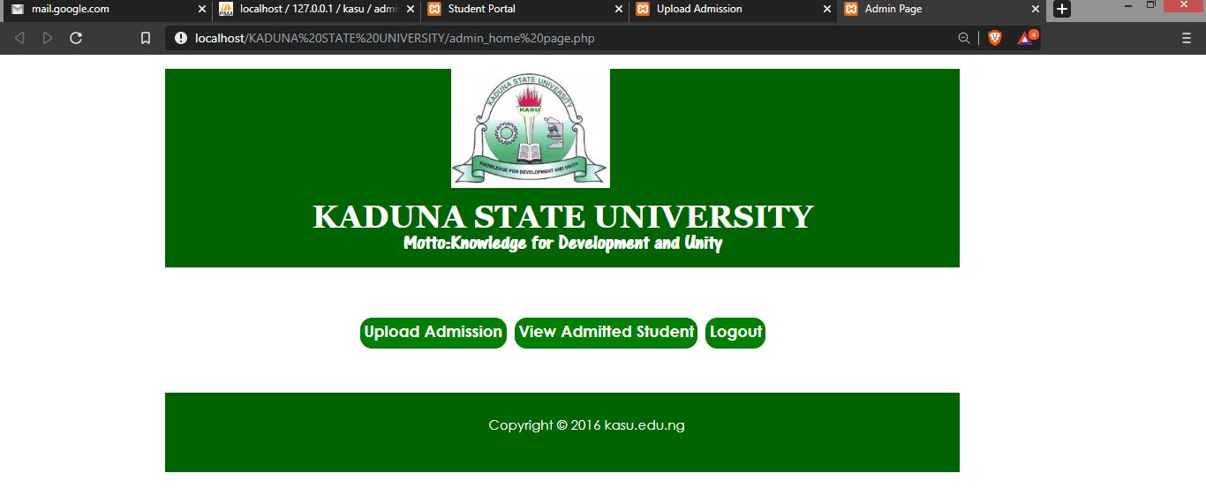
ADMIN DASHBOARD

Slide 11
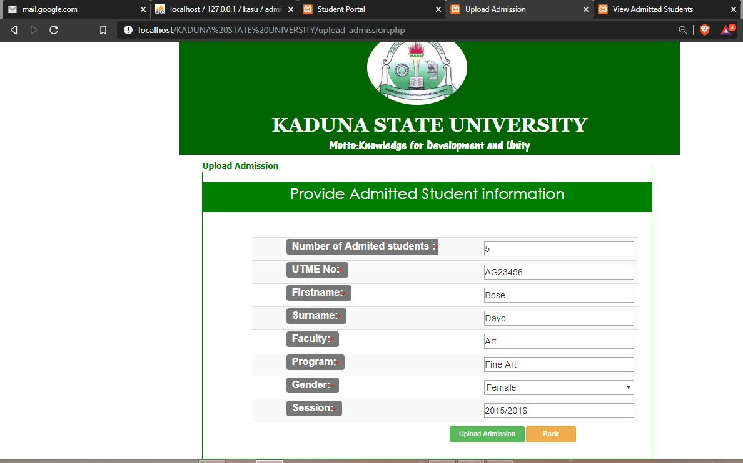
UPLOADING PAGE

Slide 12
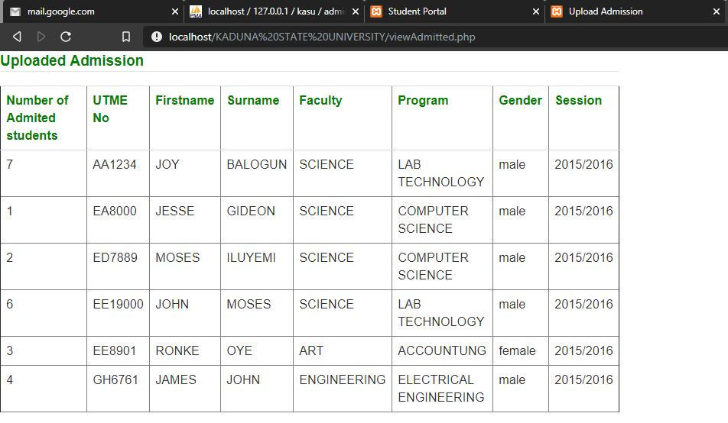
VIEW ALL ADMITTED CANDIDATES

Slide 13
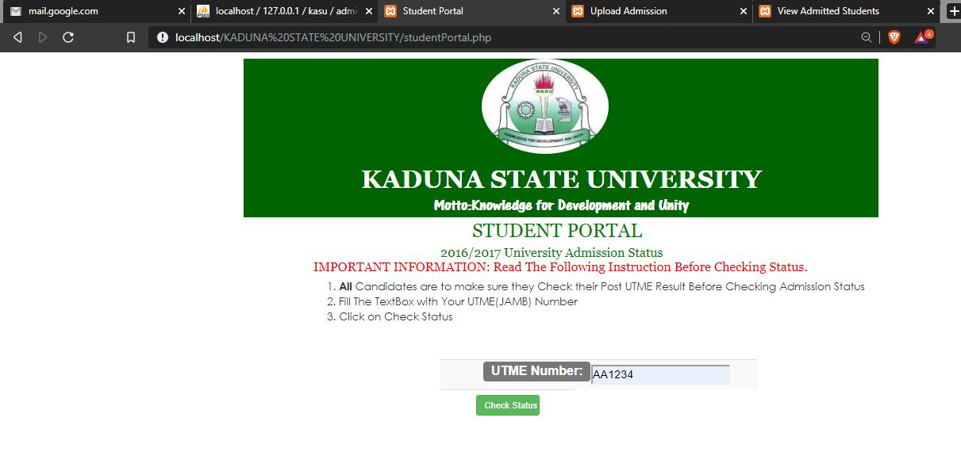
CHECKING PORTAL

Slide 14
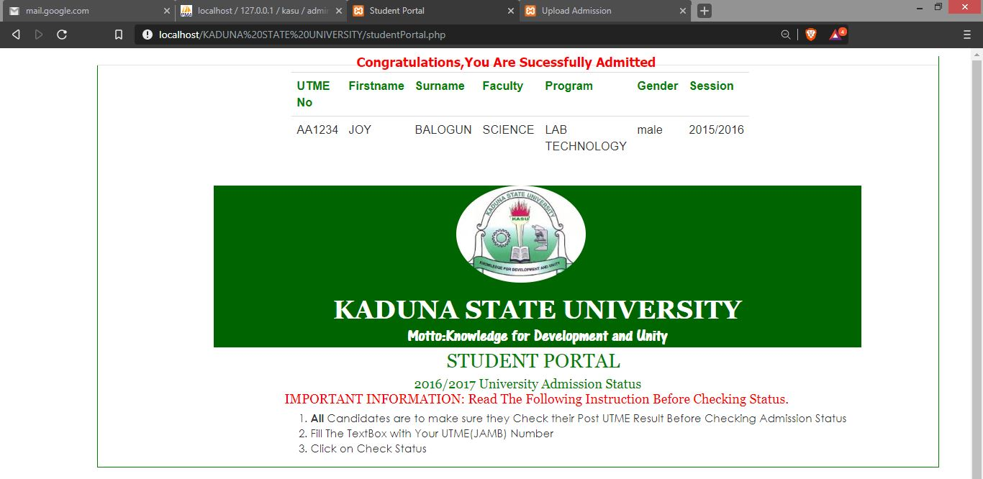
SUCCESSFULLY ADMITTED CANDIDATES

Slide 15
CONCLUSION
The Students’ Industrial Work Experience Scheme has positively contributed to my development as a future computer scientist. I was glad to be acquainted with the next generation of Web development technologies.

Slide 16
THANK YOU FOR YOUR AUDIENCE

